Slide 1


IPS Meeting 2025-Singapore
Nasaru Khan
(D20066)
PhD Research Scholar
Supervisor
Dr. Pradeep Kumar
School of Physical Sciences
Indian Institute of Technology Mandi

Slide 2
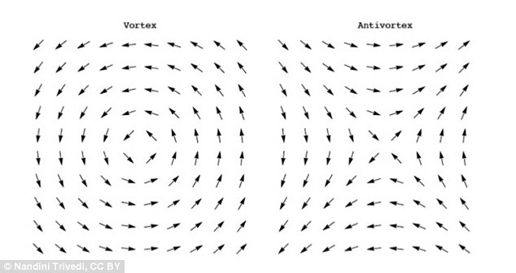
Berezinskii-Kosterlitz-Thouless (BKT) transition
Mermin-Wagner Theorem (1966): In systems with continuous symmetry (e.g., Heisenberg or XY models) and dimensions d ≤ 2, long-range magnetic order is suppressed at finite temperatures due to strong thermal fluctuations.
Topological BKT transition: Occurs in 2D systems with continuous symmetry (Such as 2D XY systems, 2D superfluids, thin superconducting films)
Correlation functions
Above T_{BKT}
Disordered state
Exponential decay of correlation functions
Free Vortex-antivortex
C(r) ∼ r^{−η(T)} with 0 < η(T) < ¼ (T < T_{BKT})
​
C(r) ∼ e−^{r/ξ(T)} (T > T_{BKT})
Below T_{BKT}
No true long range order
Power low decay of correlation functions
Bound Vortex-antivortex pairs

Slide 3
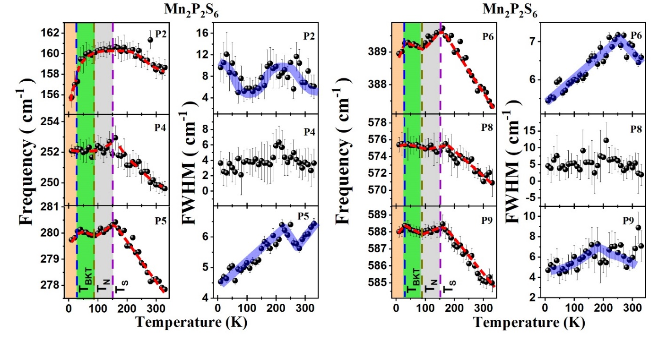
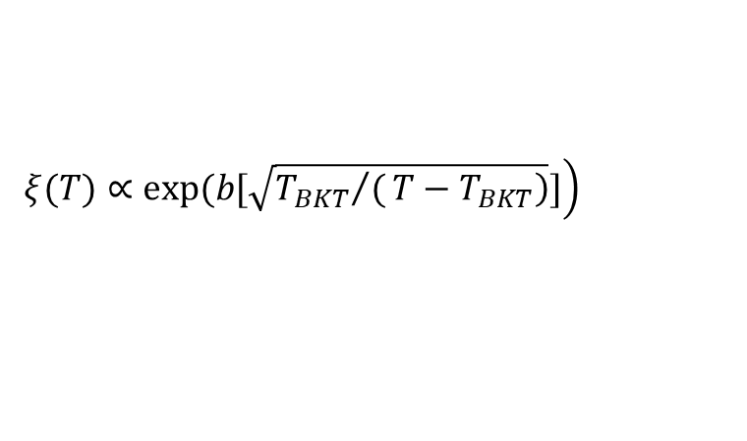
Short and long-range magnetic ordering and emergent topological transition in (Mn_{1-x}Ni_{x})₂P₂S₆
Spin-spin correlation length
$$\left.ξ(T)∝exp(b[\sqrt{\left.{T_{BKT}}/(T−T_{BKT}\right)}]\right)$$
X | T_{BKT} (K) | T_{N} (K) | T_{S} (K)
0 | 24 | 80 | 150
0.3 | 20 | 60 | 140
0.7 | 40 | 70 | 170
1 | 60 | 153
System | T_{BKT} (K) | b
X=0.7 | 31 | 1.04
X=0.3 | 22 | 1.39

