Slide 1
PO.5 Quantifying Polarization Mode Dispersion-induced Errors in Quantum Communications
Rui Ming Chua^{1,2*}, Vadim Rodimin¹, Konstantin Kravtsov¹, Gianluca De Santis¹, Aleksei Ponasenko¹, Yury Kurochkin¹, Alexander Ling^{2,3} and James A. Grieve¹
¹Quantum Research Centre, Technology Innovation Institute, Abu Dhabi, United Arab Emirates
²Centre for Quantum Technologies, 3 Science Drive 2, National University of Singapore, 117543 Singapore
³Department of Physics, National University of Singapore, Blk S12, 2 Science Drive 3, 117551 Singapore

Slide 2
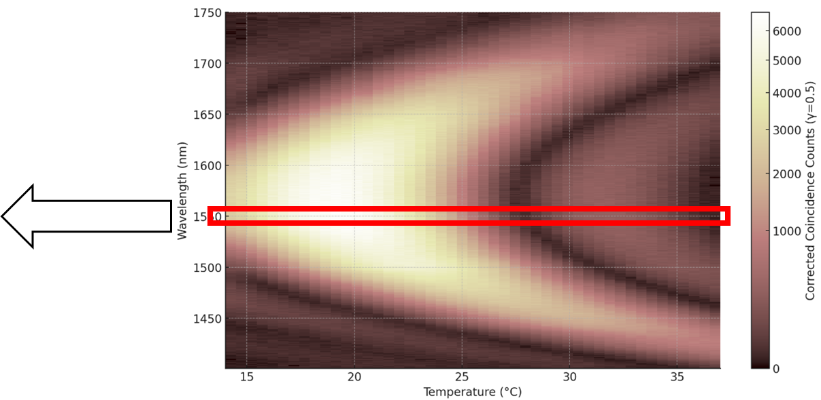
Motivation: Filtering is Frustrating!
Dispersion contributes to error in Quantum Communications
Solution 1: Filtering
Solution 2: Understand it, correct for it (if possible), or else plan for it (How much to expect?/How much to filter?)
Polarization Mode Dispersion
Our system uses 2nm filters
Our C-band Polarization Entangled Photon Pair Source based on Type-0 Spontaneous Parametric Down Conversion (Credits to my colleague Vadim)

Slide 3
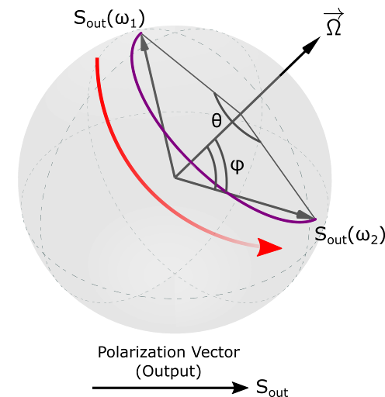


First Principles Approach
Examine Wavelength-dependent Rotation on Poincaré Sphere
Measurement Error Probability: Projected onto Measurement State
Derived: Upper limit to Polarization Mode Dispersion-induced Error for Polarization Mode Dispersion of the 1st Order
(Validated with Quantum Key Distribution Experiments)

Slide 4
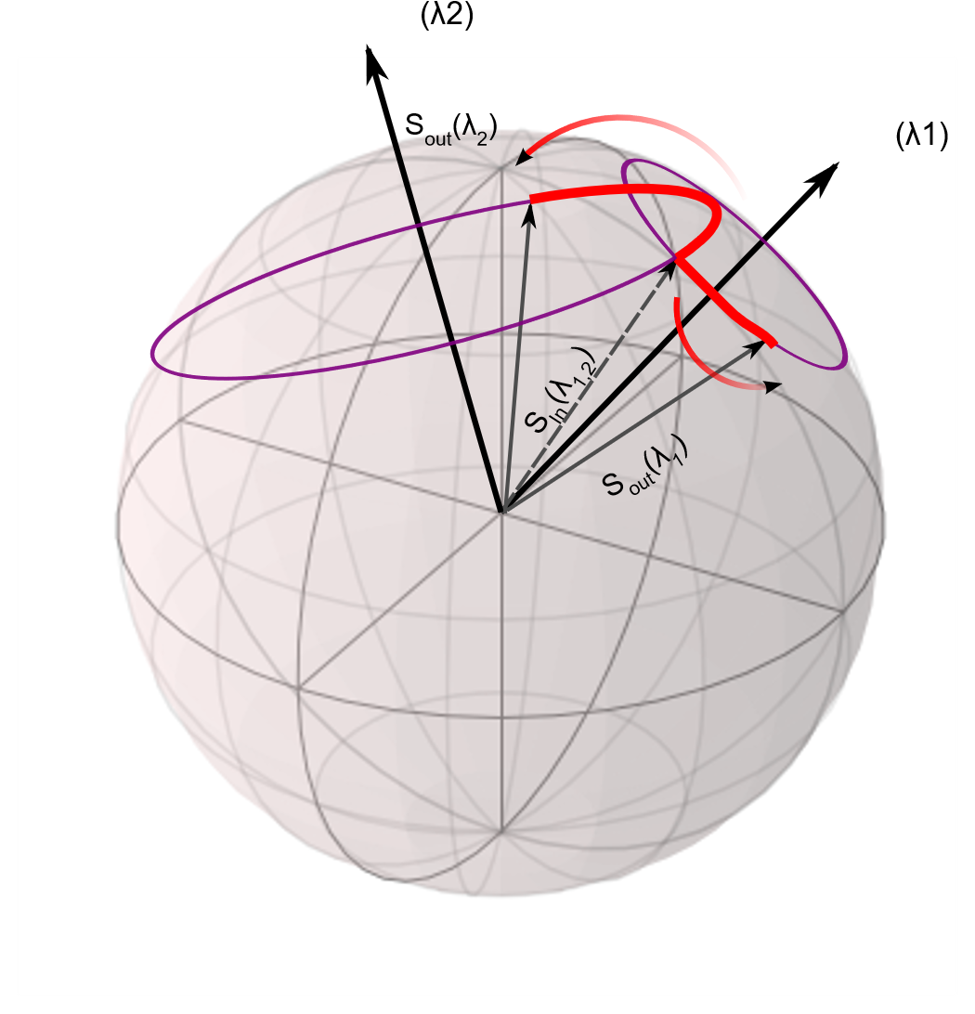
Key Findings
First Principles Approach to Model Polarization Mode Dispersion
Derived Upper Limit of Error (1st Order)
Extended to Higher Order PMD
Mitigation Techniques
(Independently Verified & Published)
(Nonlocal) PMD Compensation
Higher Order PMD considers Wavelength-Dependent PMD vectors

Slide 5
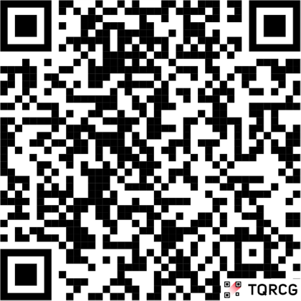
Find Out More
Contact me
In-person
Online
ruiming.chua@tii.ae
e0031524@u.nus.edu
Check out our poster
PO.5
Check out our paper
Physical Review A (Published on Monday!)
Link to Publication

